Slide 1

Capital One Hackathon Project
Made by: Los Pepinos

Slide 2

Prompt Idea
The travel planning app industry has seen substantial growth in recent years, fueled by rising demand for personalized and convenient travel experiences. In this context, Capital One aims to enhance the travel experience for its credit cardholders by developing an app that utilizes transaction data and other parameters to generate personalized travel itineraries.

Slide 3

Introduction
We started researching information from the current market to use them as guidelines to what ideas could be implemented.
Pricing ranges
Destinations
Flight deals
And more…
We also studied our own capabilities and deficiencies to get a better understanding on where we stand as a company.
Better customer information
Capital One Travel

Slide 4
After our research we noticed we could focus on two possible paths to implement the itinerary recommendation.
Create and implement a subsection inside the already created Capital One Travel app/website.
Create a new app/website with the implementation.

Slide 5
Pricing
$...
Regarding implementation costs, we cannot provide a specific figure due to the variability that could arise depending on whether we start from scratch or not. (The two paths)
Capital One does not disclose the investments made in the development of its applications or website, and for these reasons, we cannot provide a specific figure.
Utilizing Capital One Travel's existing infrastructure has both pros and cons compared to starting from scratch. These aspects are crucial to evaluate the path forward in our product proposal.

Slide 6

Pros of implementing on Capital One Travel platforms
Implementing the itinerary recommendations as an added section on Capital One Travel could:
Lower Costs of Initial Development- Developing a subcategory within a webpage generally requires less time and resources than creating an entirely new application.
Lower Costs of maintenance- Once the subcategory is integrated in the webpage, ongoing maintenance is more economical than maintaining an independent application.
Easier future implementations or updates - You can implement changes and new features more quickly and efficiently

Slide 7

Pros of Implementing on New App/Website
It would allow for clearer analytical data since having a dedicated website makes easier to track and analyze metrics.
Expandability and Flexibility: Building a new web page offers greater flexibility in terms of feature expansion and future updates.
Branding and Marketing: A new web page provides an opportunity for distinct branding and marketing efforts.
Technical Considerations: Separating the travel itinerary recommendation service into its own web page can simplify technical implementation and maintenance.

Slide 8
Competition
Capital One competes in the travel planning app market against industries such as TripAdvisor, Expedia, Airbnb, TripIt and Hopper.
In the realm of personalized travel itinerary apps, Capital One faces competition from several companies offering similar solutions:
Hopper: Utilizes AI to predict flight prices and recommend optimal booking times. Offers personalized itinerary creation based on user preferences.
TripIt: Allows users to create personalized travel itineraries from their booking confirmation emails. Users can also share itineraries with friends and family.
Kayak: A travel platform enabling users to search and book flights, hotels, and rental cars. Provides options for creating personalized itineraries and receiving price alerts.
Expedia: A travel platform allowing users to search and book flights, hotels, and rental cars. Offers personalized itinerary creation and price alerts.

Slide 9
Capital One, it's different!
Differentiation will be key to Capital One's success in this space, emphasizing the app's ability to generate personalized itineraries based on financial and transaction data.
Advantages of Capital One:
Detailed financial data access: Capital One utilizes detailed transaction data from its credit cardholders to understand spending patterns, enabling highly personalized travel recommendations.
Financial product integration: Capital One's travel app integrates seamlessly with its other financial products, like travel credit cards and rewards programs, bookings and offering exclusive benefits.
Consumer security focus: Capital One prioritizes consumer security and protection throughout the travel planning process, including real-time security notifications, fraud protection, and data privacy guarantees.

Slide 10

Possible Weaknesses of Our Own App/Website:
Privacy and Security Concerns: Mishandling sensitive financial data access could raise privacy and security issues.
Poor User Experience: A non-intuitive interface or usability issues may drive users towards simpler, competitor-provided solutions.
Technological Limitations: Lack of robust technological infrastructure or key features like accurate and timely recommendations may frustrate users, leading them to explore alternative options.

Slide 11
Prototype Development
The Prototype we implemented is based on 3 subphases:
Subphase 1: Data Management
Use the wealth of data stored in Capital One's pre-existing databases as the foundation for our prototype.
Explore transactional records, spending patterns, and user behaviors to inform the personalized travel planning features.
Consider a more advanced future implementation by incorporating NESSIE, Capital One's simulated database, for cutting-edge testing and refinements.
NESSIE provides a simulated environment to test the prototype with real scenarios, ensuring robustness and adaptability.

Slide 12
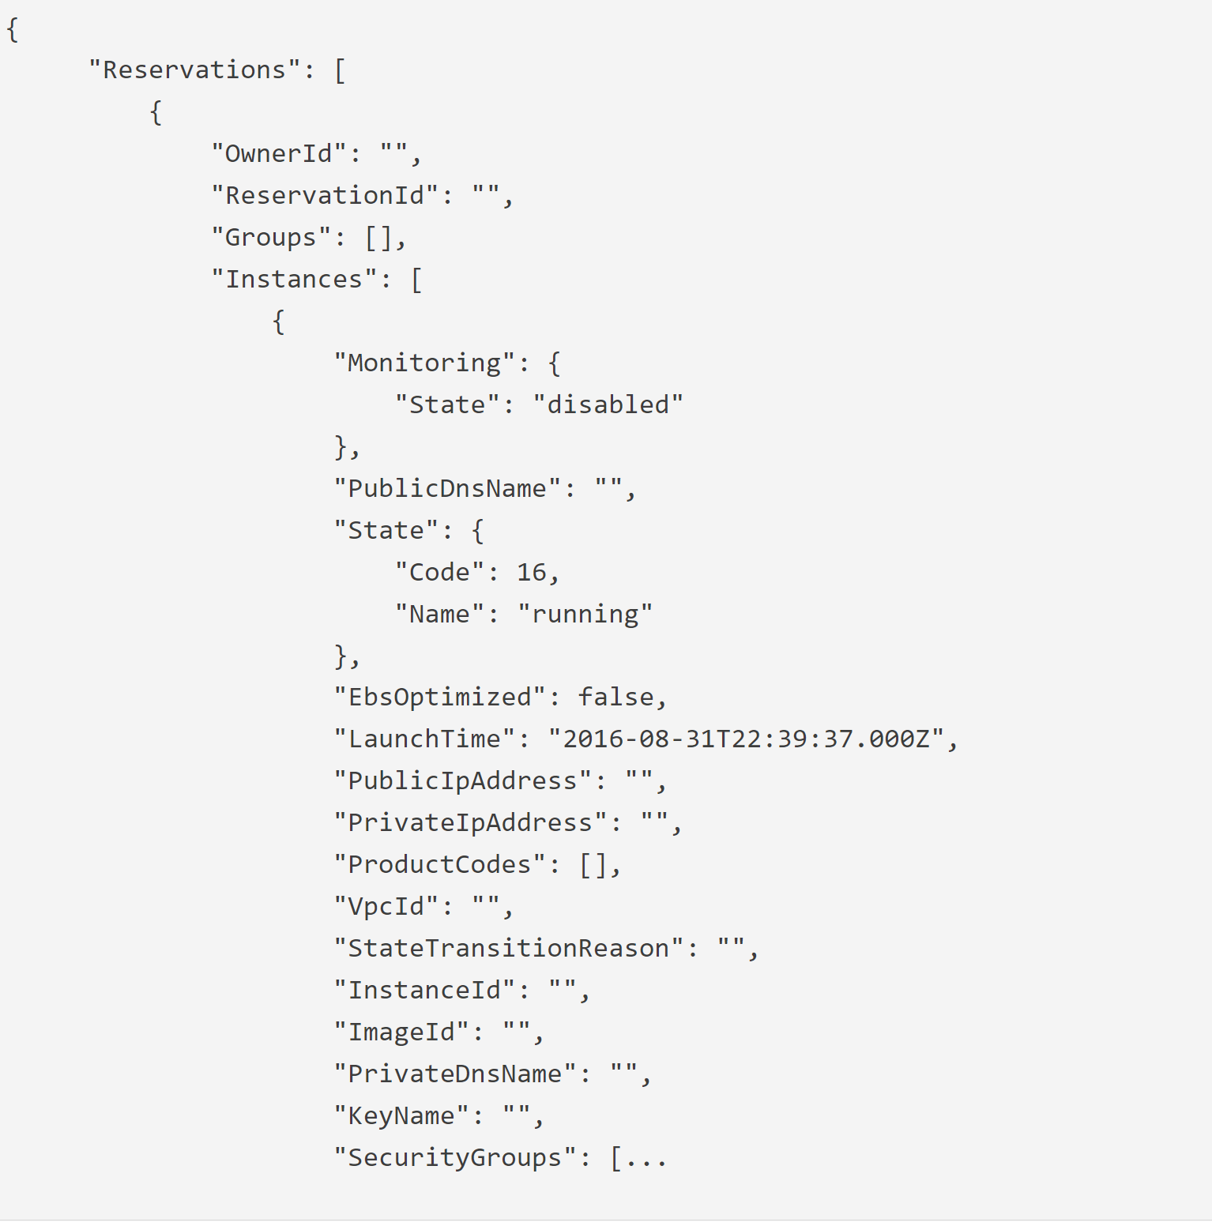
How we managed the data

Slide 13
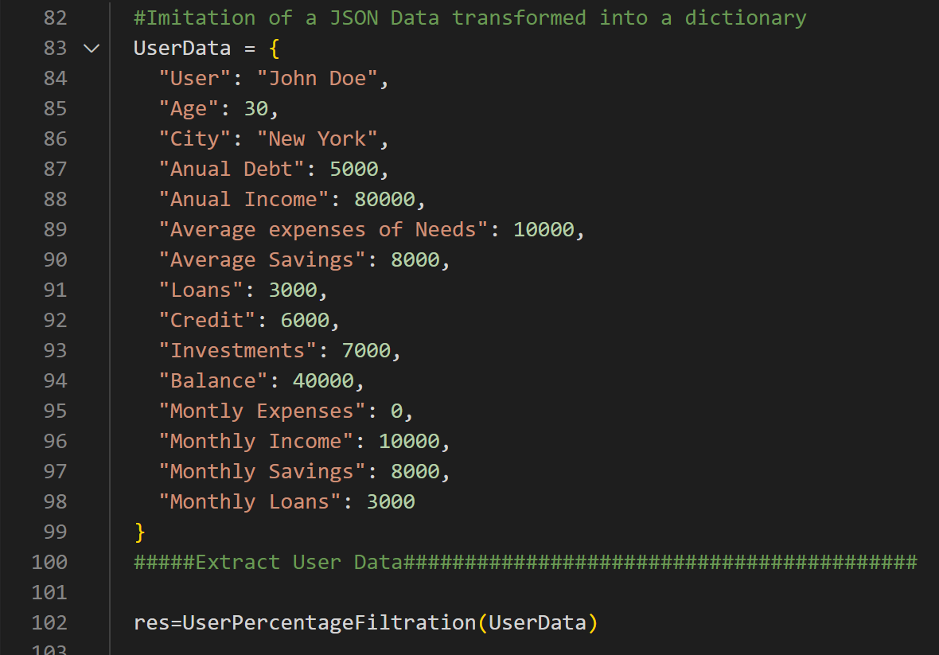
Managing the Data

Slide 14
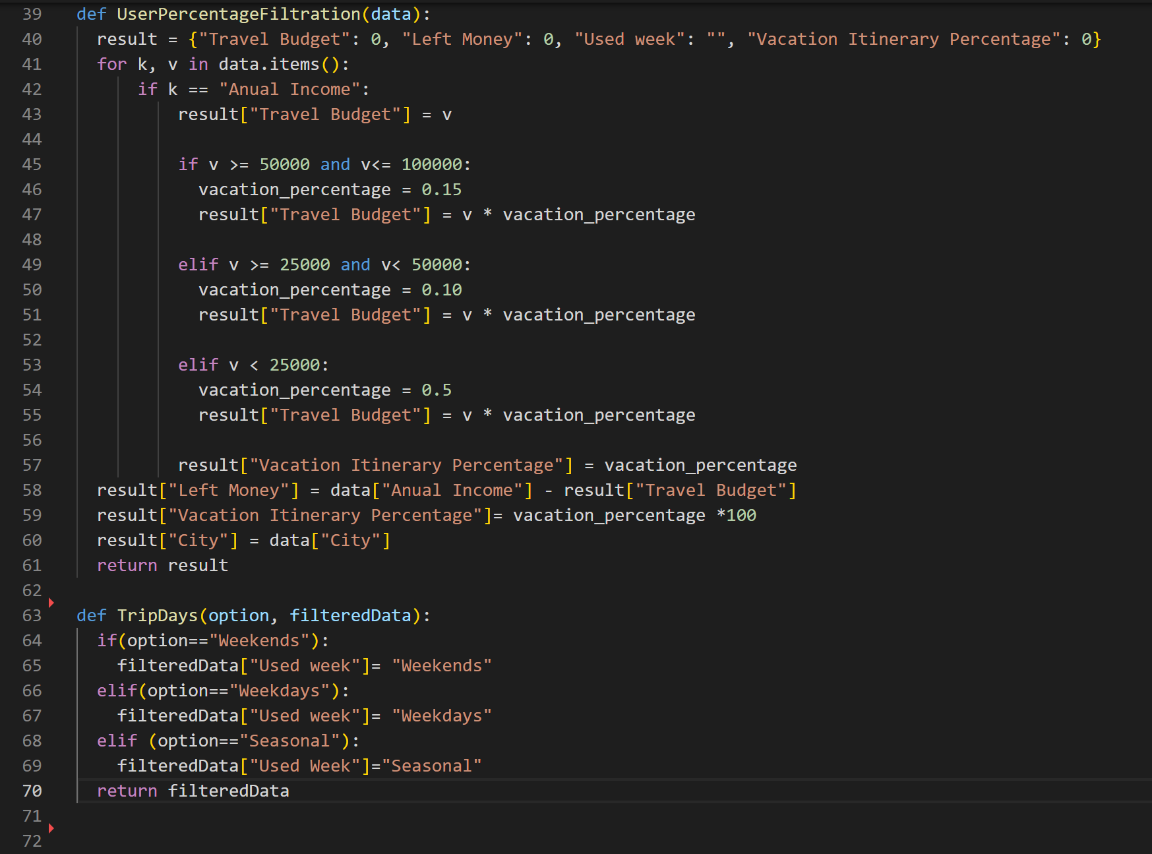
Filtering the data

Slide 15
Prototype Development
Subphase 2: Search Engine
Since our code has the capacity to search for information on the internet it does retreat and helps with the filtering for itinerary purposes.
According to some limited resources Capital One currently lacks of direct affiliations with travel agencies or airlines and our prototype creates a promising ground for exploring strategic partnerships.

Slide 16
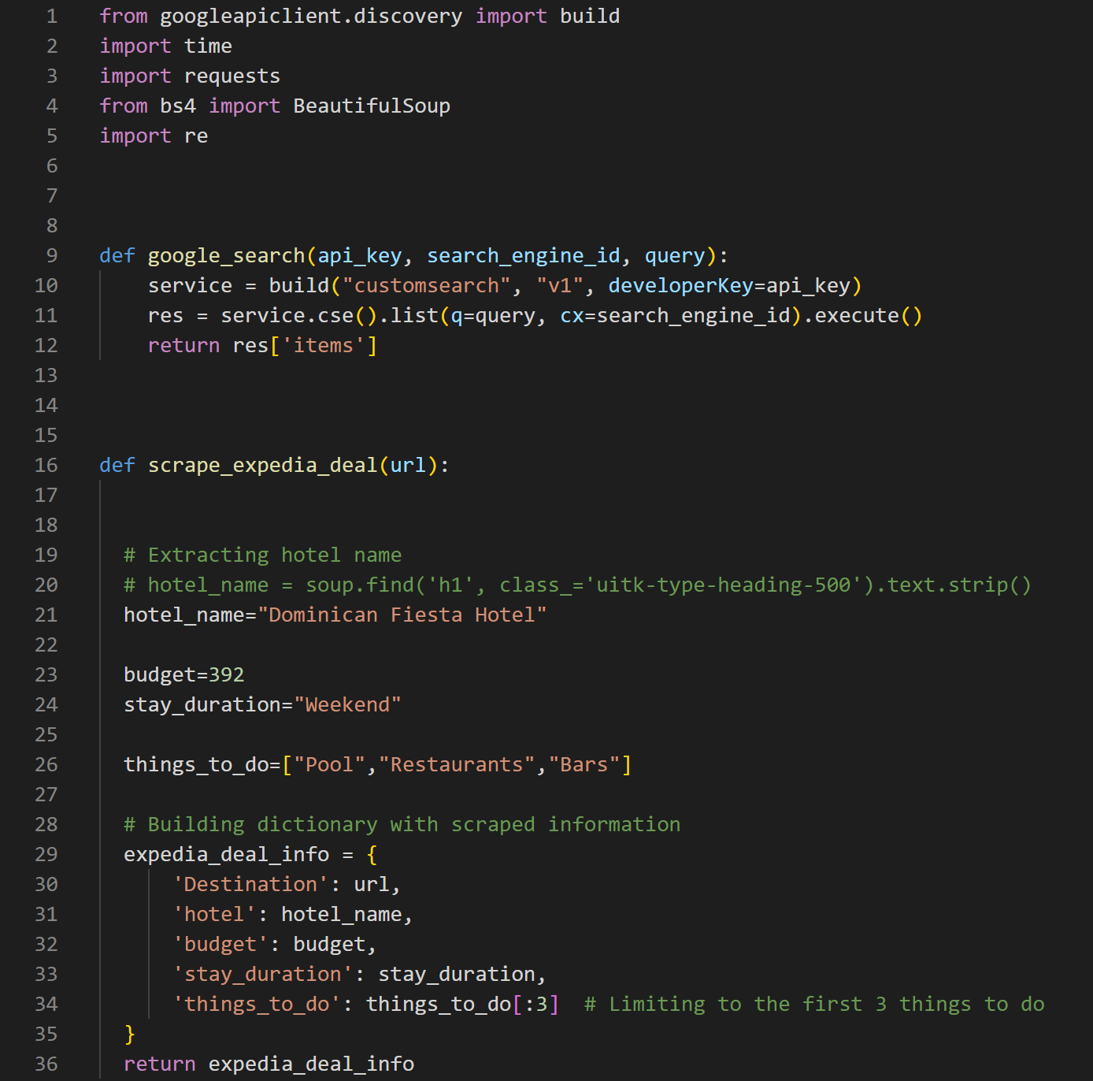
Implementation of the Search Engine

Slide 17
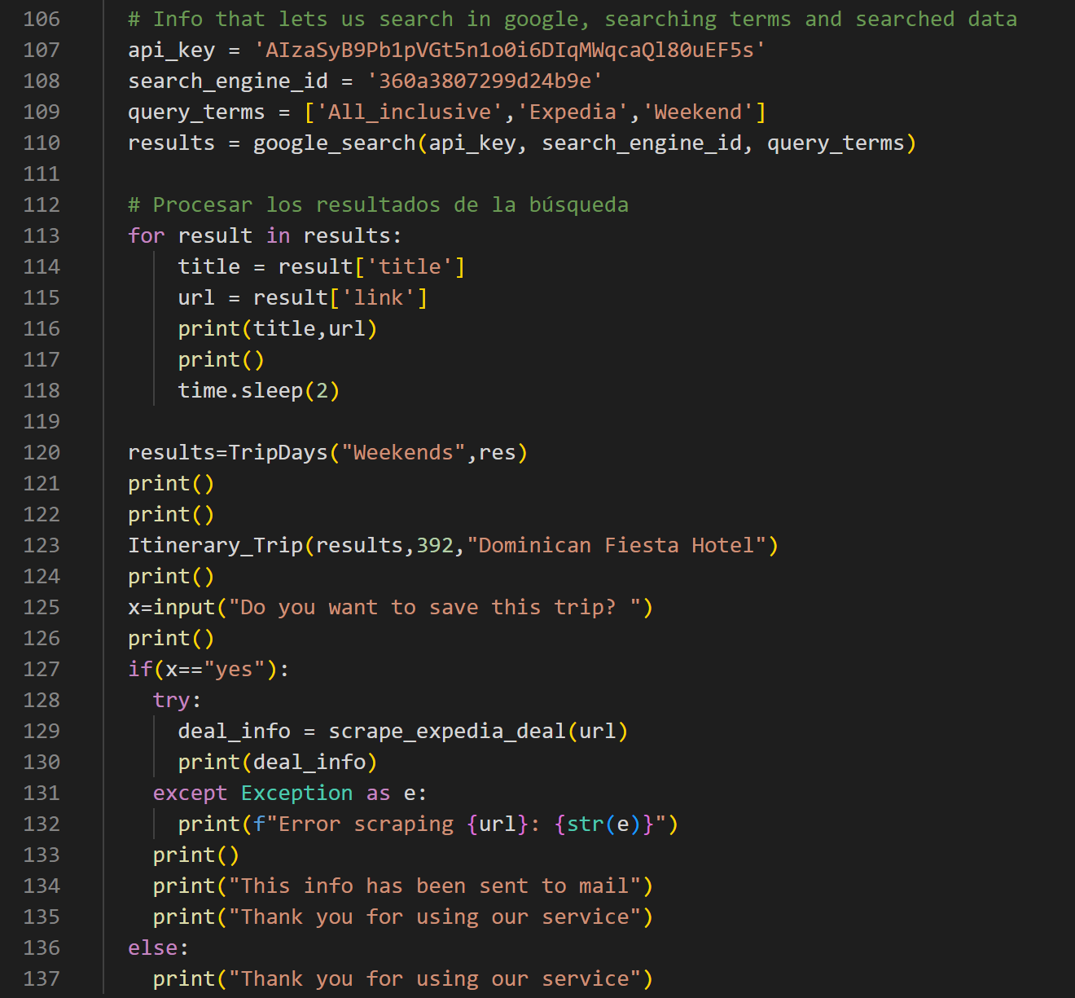
Search engine way to access

Slide 18
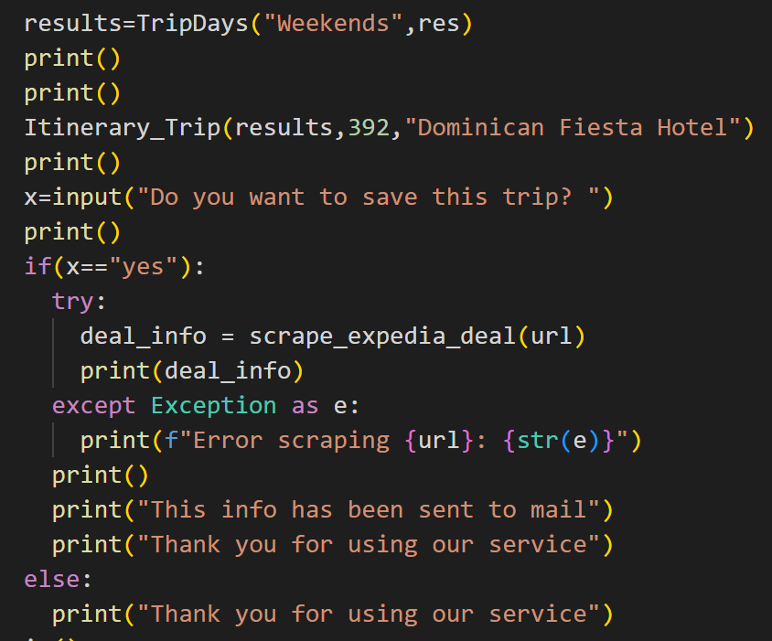
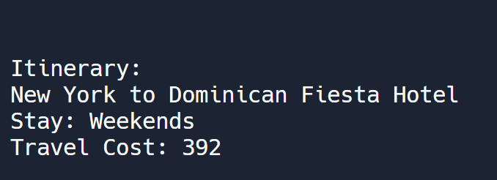
Prototype Development
Subphase 3: Itinerary Creation
Based on the acquired data and the filtered user information, we developed a product that let us provide an itinerary based on the customers preferences and algorithms.

Slide 19
Our Learning Experience!

Slide 20
Thanks!
Feel free to ask us any questions!!!
Please keep this slide for attribution

